Slide 1
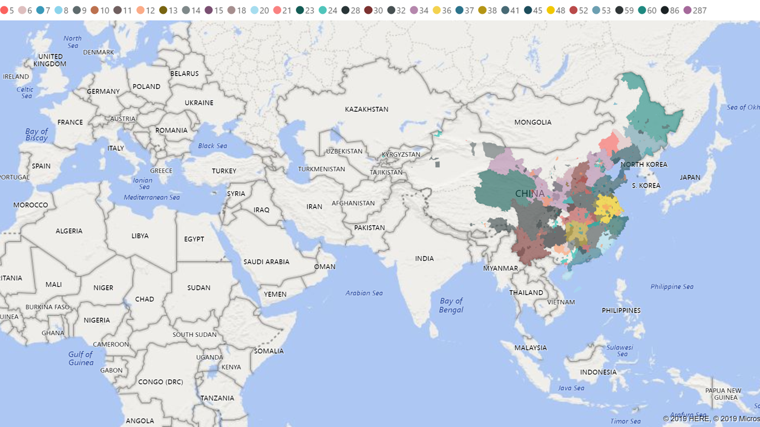

Slide 2
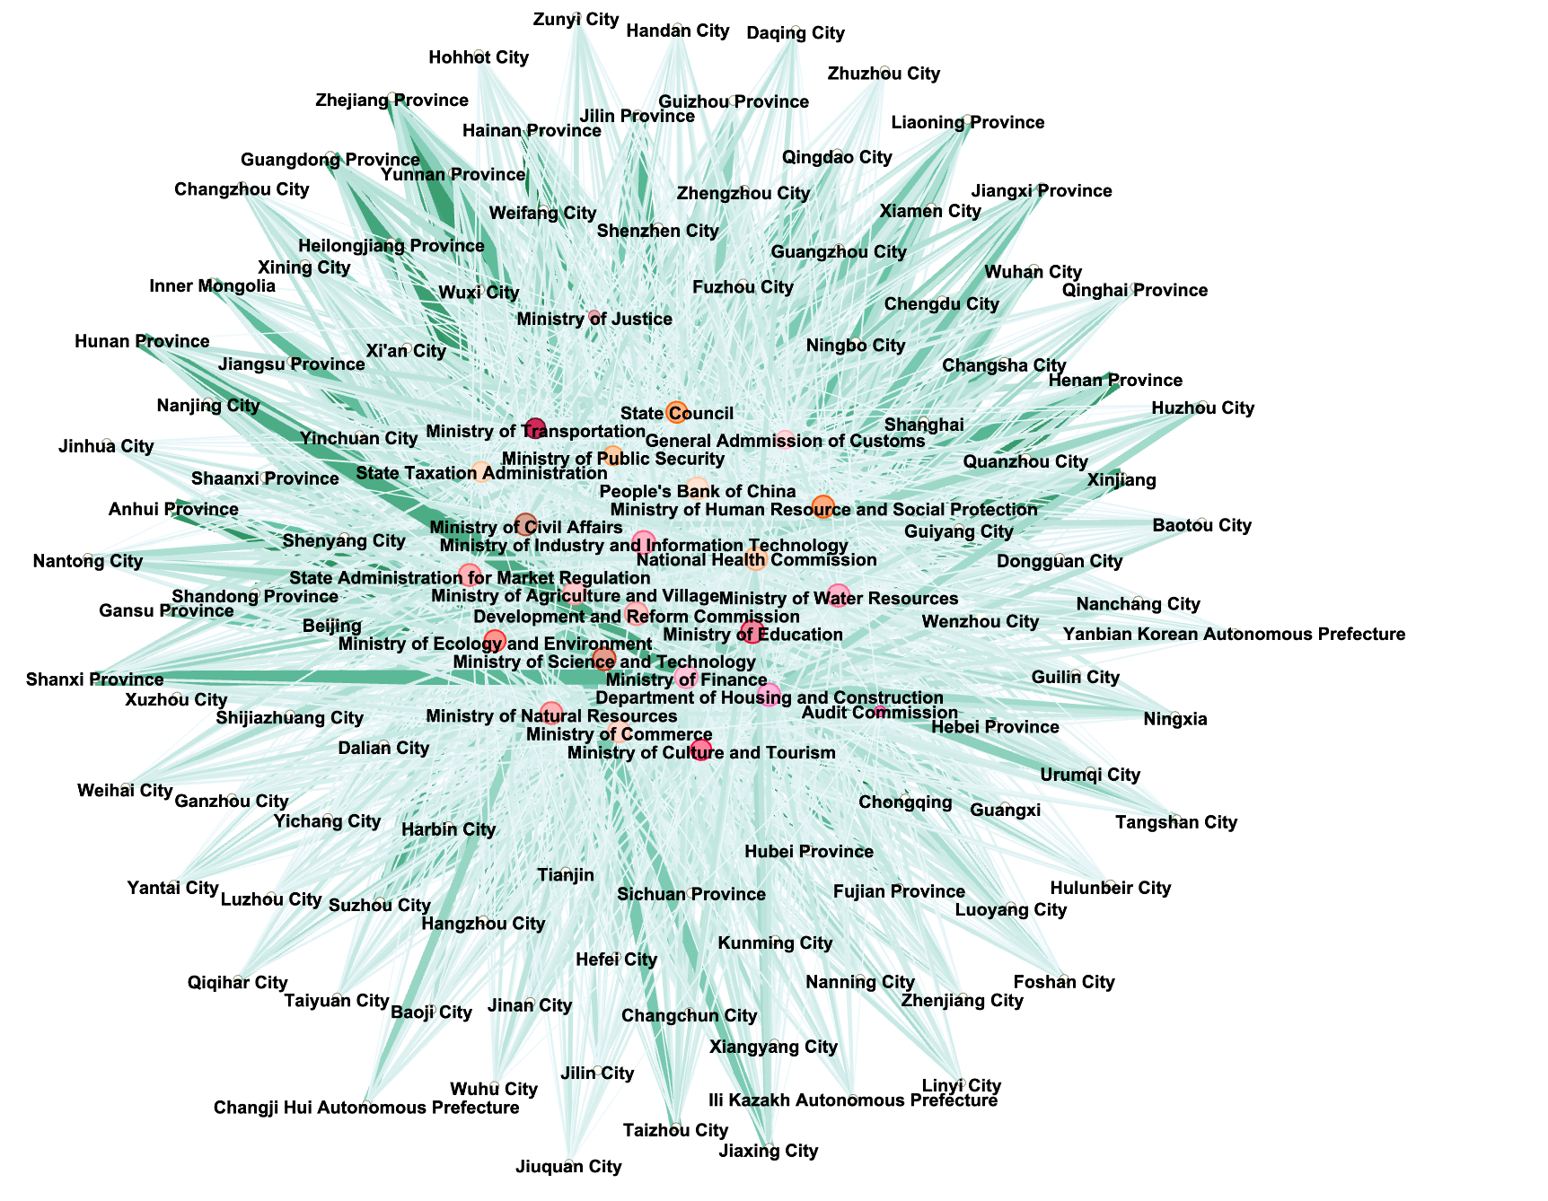

Slide 3
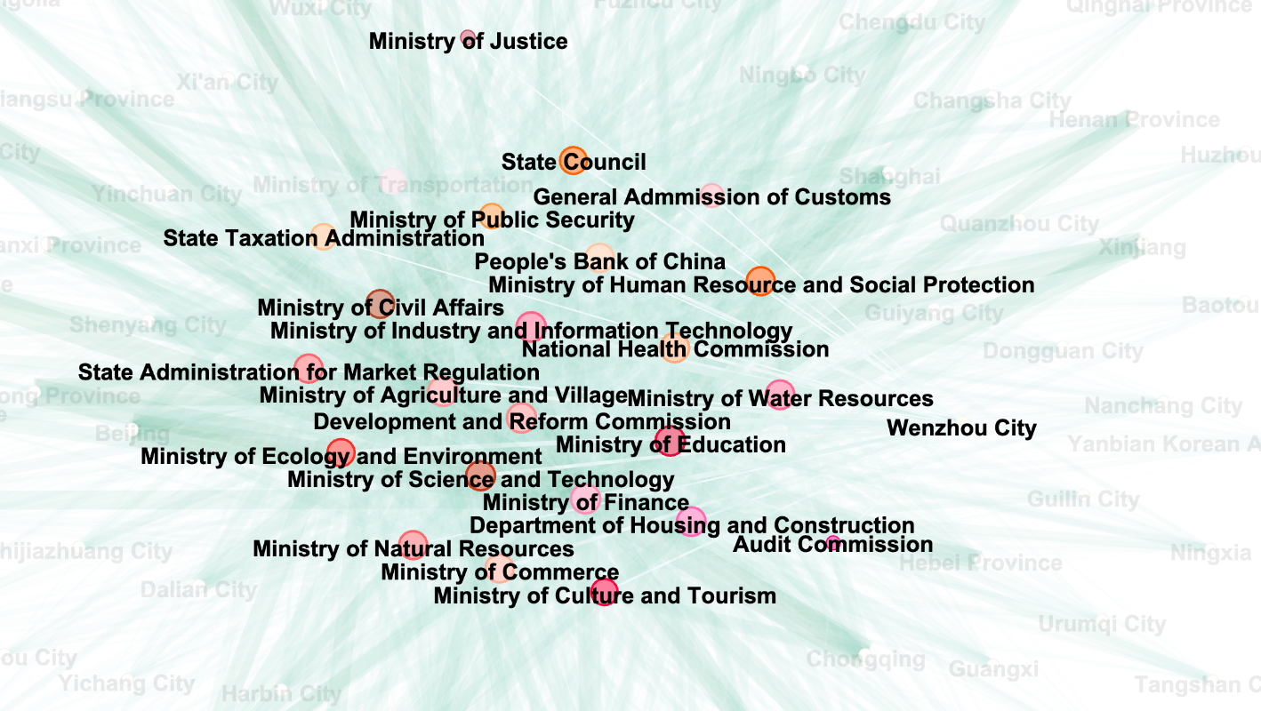
Microscope

Slide 4
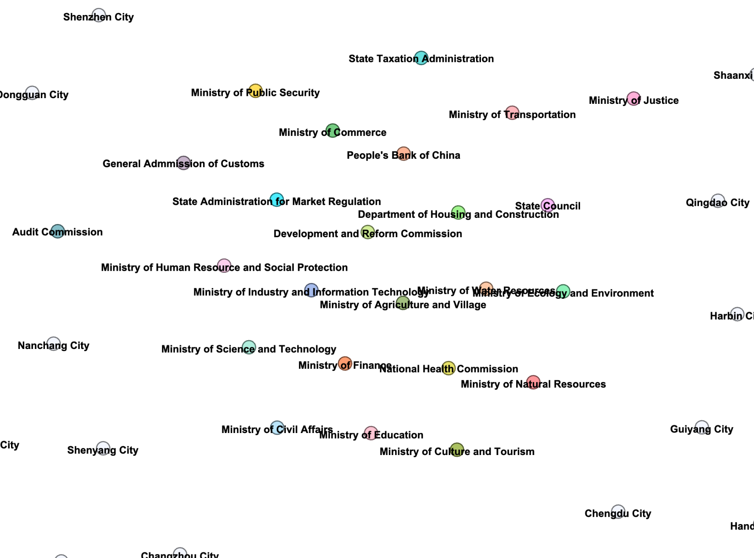
Ministries /Bureaucracies at core part

Slide 5
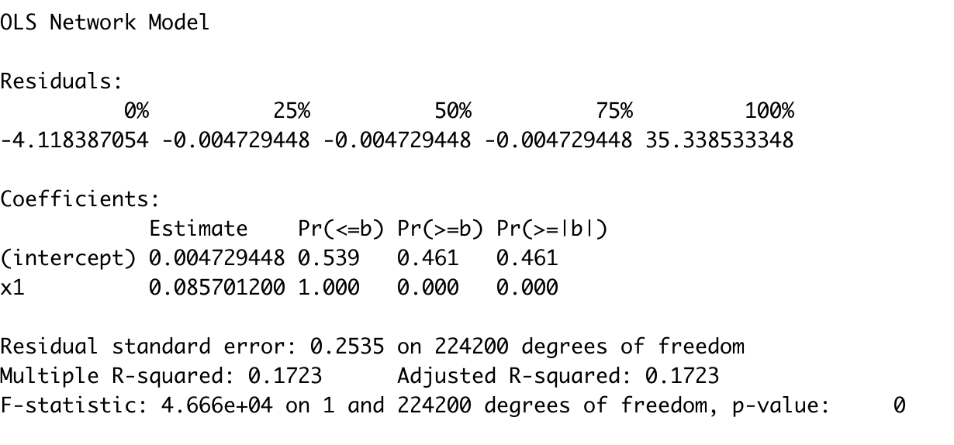
Two-mode network Test Results
Interpretation:

Slide 6
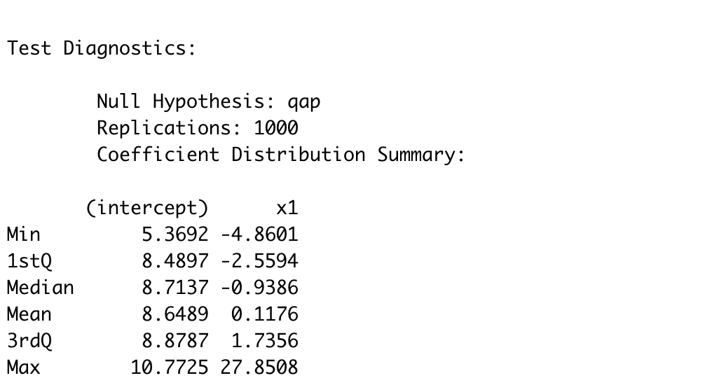
Two-mode network Test Results

Slide 7
Citation
Borgatti, S.P., Everett, M.G. and Freeman, L.C. 2002. Ucinet 6 for Windows: Software for Social Network Analysis. Harvard, MA: Analytic Technologies.

